Slide 1
TRAVEL WITHOUT TRAFFIC
BY:
Team name : Shiny Sparks
Team leader : KIRTHANA.R.D

Slide 2
OVERVIEW:
This application will be used to book ticket(public bus) like a railway ticket booking where user would see next available list if the number of ticket have crossed limit(to ensure social distancing) and also shows the available dates.
It could be booked via website and through message. In traffic module , traffic police could set the time limit and upload the traffic picture captured through camera(simulation) and signal gets changed automatically based on traffic.

Slide 3
PURPOSE:
To avoid over traffic and ensure social distancing in public bus by reserving seats and to help traffic police to focus on other safety ,the automatic signal changer helps to change signal for the side with traffic first then to a less traffic side.
To help manage post lockdown travel , the bus booking system would help in social distancing and the traffic could also be managed by this automatic traffic light changer which first allows the side with more vehicles then with less vehicles.

Slide 4
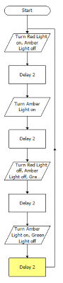
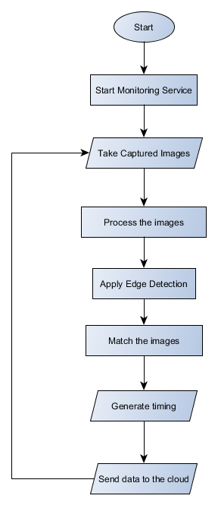
Block diagram

Slide 5
Learnings:
From bootcamp i came to know about the services of IBM cloud.
Node red uses
Chatbot creation
Classifying and detecting images
IOT applications
From doing this project I learnt how to use API’s , visual recognition and languages(flask and javascript)

Slide 6
MODULES
User:
Book tickets
Cancel tickets
View tickets
Admin:
Add ,delete , view bus
Delete, view users
View booked and cancelled tickets
Traffic police:
Upload pictures(simulation)
Set time for signal.

Slide 7
Future works:
For Traffic police : City map would be set such that the police could view traffic at any signal by clicking on it.
Also could set the time for signal.
For bus booking: Tracking the bus such user knows about timing of arrival.
Chat bot system for booking the ticket.

Slide 8
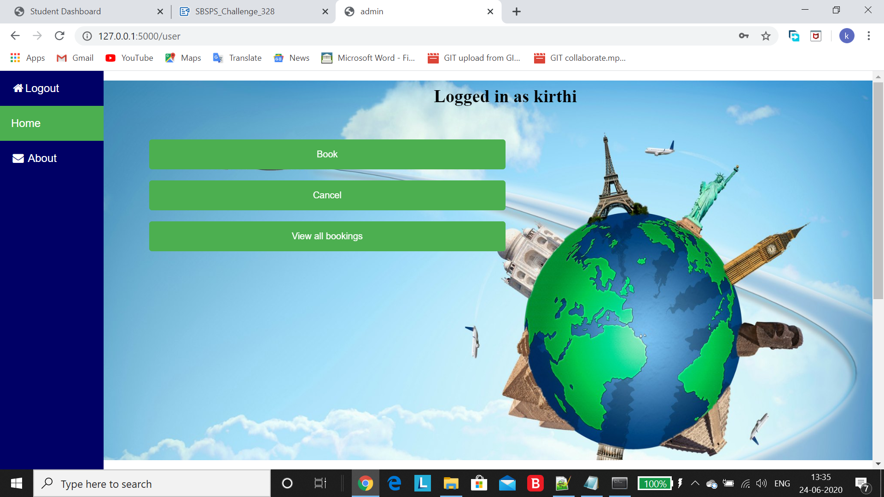
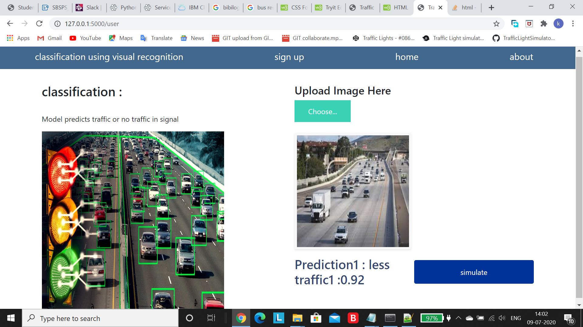
Screenshots:

Slide 9
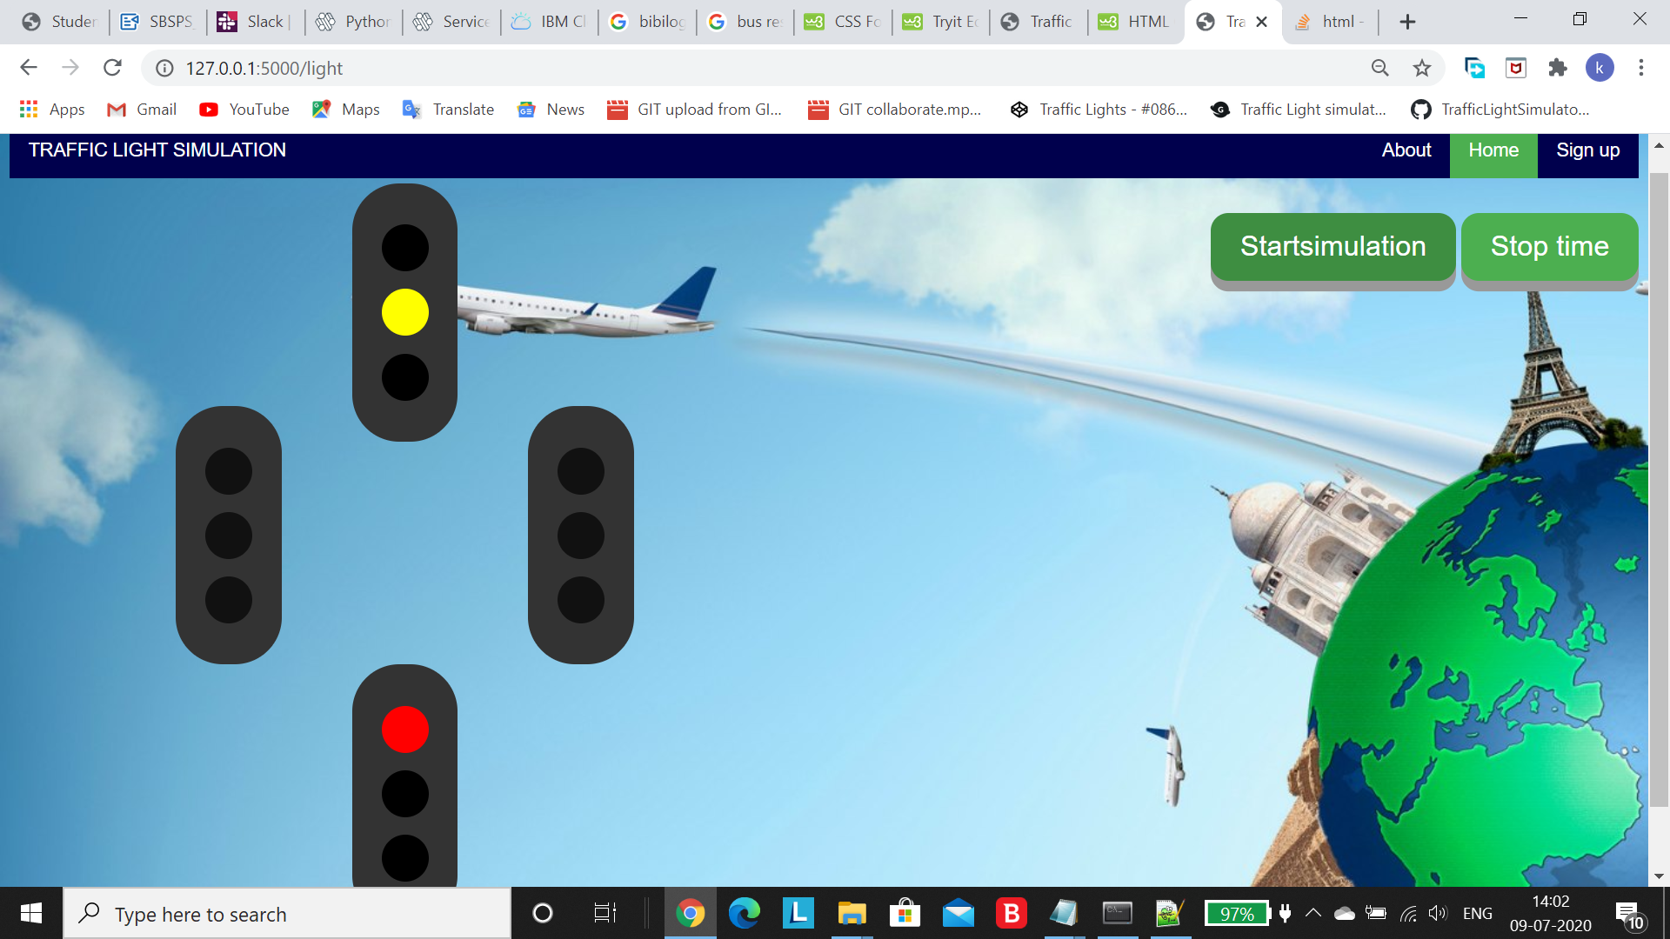
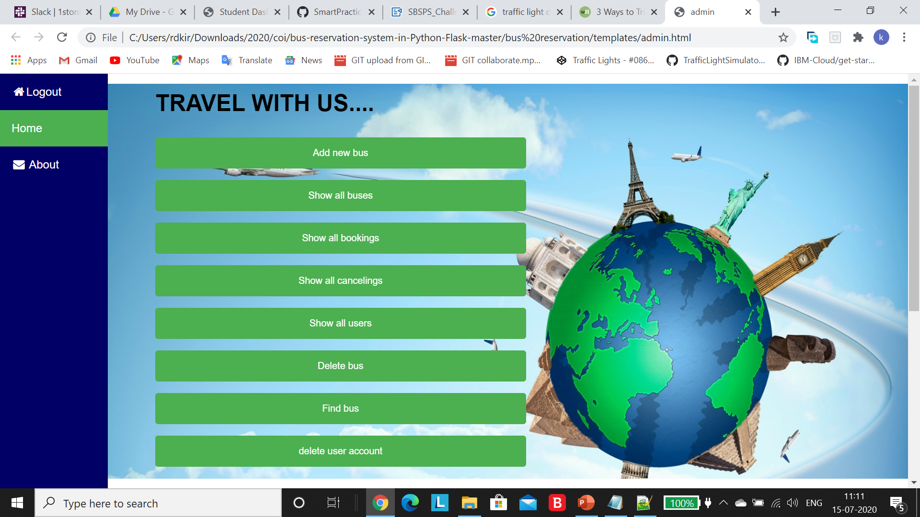
Screenshots

Slide 10


